Slide 1







Green Sync
Let's Clean Our Country Artificially.

Slide 2






Group Members:
SHAHZAIB SALEEM
HUSSAIN ALI
MUSKAN
MUHAMMAD TAHA
2022-CS-124
2022-CS-129
2022-CS-38
2022-CS-139

Slide 3



Table of Content:
Overview
Why this Project?
Project need in Society
Project Management Approach
Agile/Scrum Implementations
Tool Used
Challenges
Solution
Conclusion

Slide 4


OVERVIEW:
Green Sync
Smart waste management app
Report Waste
Snap a photo of nearby waste.
AI Analysis Identifies waste type & location.
Quick Cleanup
Alerts authorities for action.

Slide 5





Project Features:
User authentication
Dashboard
Report Submission
Report Entertainment

Slide 6

Approach used:
Why Agile?
Agile Framework
Agile delivers value incrementally, adapts to change, and ensures collaboration, making it perfect for Green Sync's evolving needs and continuous improvement.
We chose Agile for Green Sync because its flexibility, iterative delivery, and feedback-driven approach ensure the project meets community needs effectively.

Slide 7
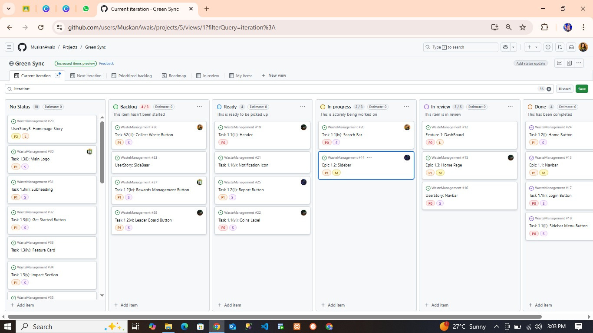
Work flow and benefits
Agile Workflow
Our Agile workflow includes sprint planning, daily standups, feature development, and sprint reviews, ensuring continuous progress and high-quality deliverables through iterative improvements.

Slide 8



github
Version control & collaboration
AI Model
TOOLs used
Image recognition for waste detection
GPS & Mapping API
Our project leverages AI to enhance waste management efficiency. It captures images of target areas, validates them using AI, and sends the data (including coordinates) to the worker team for action.
Capturing precise coordinates

Slide 9




Challenges faced
Image Accuracy Issues
Environmental Factors
Real-time Processing
Worker Coordination

Slide 10




Solution Approach
AI Model Training
GPS Optimization
Improved dataset with diverse waste images.
Enhanced Image Processing: Noise reduction techniques for better clarity.
Accurate mapping of waste locations to prevent duplicate reporting.
Automated Alerts: Smart notification system for the worker team based on priority and proximity.

Slide 11
Conclusion
Efficiency: AI reduces manual inspections, speeding up waste management.
Accuracy: Better waste detection ensures targeted clean-up efforts.
Scalability: Can be expanded to larger areas, improving city-wide waste management.
Impact: A cleaner environment with reduced human effort in waste identification.

Slide 12



Thank You
Have a Great Day

